Slide 1
NEXT HIKES & DIGICROME PROJECT-1 Manual calculator
By: Pradeep Rajwade

Slide 2
PROJECT OVERVIEW
An equation display area (screen) to exhibit the mathematical expressions and their respective results.
Clickable buttons, each representing numerical values or mathematical operations.
Core mathematical operations functionality, encompassing addition, subtraction, multiplication, and division.
Seamless execution of mathematical calculations, yielding results (=), coupled with the ability to clear the equation display (c).

Slide 3
LEARNING OUTCOMES
1. Core Python
2. tkinter Library
3 Visual Studio Code[IDE]
4. GitHub
5. Application development using Python programming language

Slide 4
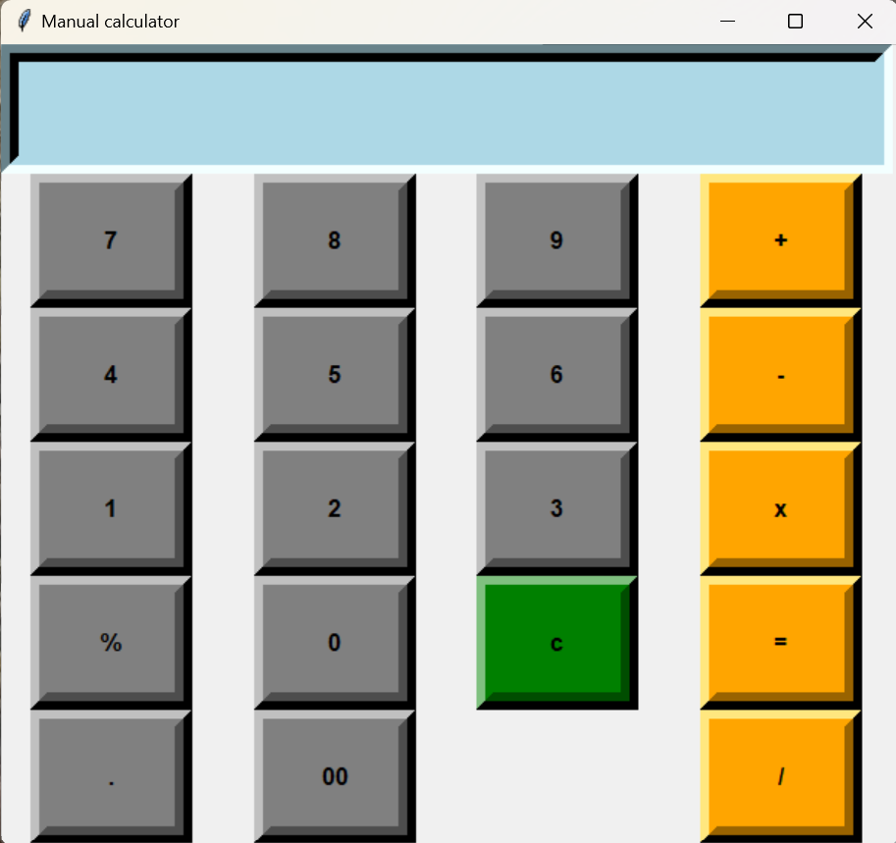
APPLICATION VIEW

Slide 5
KEY FEATURES
Basic arithmetic operation :The manual calculator developed from VS code can handled all the arithmetic function like addition, multiplication, subtraction, division etc.
User input handling: Prompting the user to input numbers and operators and validating the input to ensure it is in the correct format.
Error handling: Implemented error handling mechanism to deal with invalid input.
Decimal: Supporting decimal number for calculation.
User interface: Depending upon the complexity of the calculator we Can chose to implement acommand line interface or gui using tkinter library.

Slide 6
KEY CHALLENGES
User interface design: Designing user interface is the major challenges faced during project preparation.
Defining clear function.
Defining equal function.
Visual studio code: As we are new to handle VSC , so it was difficult to understand the function of vsc code .

Slide 7
Result and achievements
Familiar with TKINTER,VISIUAL STUDIO CODE.
Git hub
Improved problem solving skills.
Improved programming skills.

Slide 8
Overview of tool
TKINTER:Tkinter tool is very user friendly and provide you a vast in built library ,Tkinter seamlessly integrates with python and allowing developers to leverage pythons rich ecosystem.
Tkinter provides a wide range of widget.
Ease of use:tkinter is very straight forward to learn and use.
Cross platform compatibilty

